Slide 1
MRI-to-CT Conversion Model Using Deep Learning
Capstone Project Presentation
Presented By:
Guna Shankar S
20MIA1162
Guided By:
Dr. Subbulakshmi P

Slide 2
Outline:
1️⃣Introduction
2️⃣ Literature Review
Themes Discovered in Review
Identification of Gaps based on Current Scenario/Industry Trends
3️⃣ Scope and Problem Statement
4️⃣ Research Challenges
5️⃣ Research Objective
6️⃣ Methodology (Implementation of the methodology should be at least 75% complete)
7️⃣ Results and Discussion
8️⃣ Conclusion
9️⃣ Limitations and Future Work
🔟 Snapshot of Guide Approval Email
1️⃣ References

Slide 3

Introduction :
Medical Imaging & Its Importance
Medical imaging plays a crucial role in diagnostics and treatment planning.
CT scans provide detailed imaging but expose patients to radiation.
MRI scans are safer but may lack detailed bone structure visibility.
Need for MRI-to-CT Conversion
CT scans are widely used for detecting fractures, tumors, and brain hemorrhages.
MRI is radiation-free but does not always provide sufficient anatomical details for certain diagnoses.
Converting MRI to CT can provide a non-invasive and radiation-free alternative.

Slide 4
Model Outline:
Deep Learning for Image Translation
Advances in AI and deep learning enable image-to-image translation.
Models like CycleGAN, Pix2Pix, and U-Net allow conversion of MRI images into CT-like images.
Project Objective
Develop a deep learning-based model for MRI-to-CT conversion.
Reduce dependency on CT scans while maintaining diagnostic quality.
Improve healthcare efficiency with radiation-free imaging alternatives.

Slide 5
Table 1: Medical Image Synthesis (MRI-to-CT, PET-to-CT, etc.)
Author | Year | Title | Used Model | Pros | Cons | Valuable Point
Dayarathna et al. | 2024 | Deep Learning-based Medical Image Translation | CNN, Transformer, Diffusion | Covers multiple deep learning approaches | Lacks implementation details | Comprehensive survey covering MRI-to-CT & PET-to-CT synthesis
Lei et al. | 2019 | 3D Patch-based GAN for MRI Synthesis | 3D CycleGAN | Handles discontinuity in slices | Requires large datasets | Improves image continuity between slices
Nie et al. | 2018 | Adversarial 3D FCN with Auto-Context Model | 3D cGAN | Effective in brain & pelvic imaging | High computational cost | First to introduce auto-context to medical GANs
Sun et al. | 2022 | Structure Consistency in Image Synthesis | 2.5D CycleGAN | Enhances shape consistency | Limited to brain MRIs | Uses shape-consistency loss to improve results
Koh et al. | 2022 | GAN-based MRI Enhancement | 3D GAN | Improves structural fidelity | High training time | Uses multi-view 3D patches for realistic synthesis

Slide 6
Table 2: Deep Learning Models for Medical Imaging
Author | Year | Title | Used Model | Pros | Cons | Valuable Point
Qian et al. | 2020 | Hybrid Architecture for Medical Synthesis | 2D cGAN + ResNet + U-Net | Combines multiple architectures | Computationally expensive | Uses auxiliary classifier for multi-region focus
Abu-Srhan et al. | 2021 | Attention-guided Image Synthesis | 2D CycleGAN | Sharp & accurate images | Complex loss functions | Introduces attention masks in medical GANs
Kearney et al. | 2020 | Self-attention Discriminator in GANs | 3D CycleGAN | Region-specific improvements | Needs more diverse datasets | Self-attention improves anatomical feature clarity
Ang et al. | 2022 | Hybrid Loss Functions for GANs | 2D cGAN | Enhances realism & consistency | Higher training instability | Uses perceptual & style loss for better synthesis
Chen et al. | 2021 | Cross-Modality Consistency in GANs | 2D CycleGAN | Focuses on shape preservation | Limited to abdomen MRIs | Uses crossing loss for accurate organ-level synthesis

Slide 7
Table 3: AI-driven Medical Imaging & Clinical Applications
Author | Year | Title | Used Model | Pros | Cons | Valuable Point
Shi et al. | 2021 | High-frequency Feature Identification in CT | 3D U-Net | Improves image texture | Requires tuning for different organs | Focuses on high-frequency CT image parts
Armanious et al. | 2019 | Perceptual Loss for Image Synthesis | 2D CycleGAN | Enhances perceptual quality | More parameters to tune | Uses perceptual loss to improve structural details
Zhao et al. | 2023 | Residual Transformer-GAN for Feature Extraction | Transformer + GAN | Effective in multi-level features | Transformer models require large data | Uses feature reconstruction loss for sharper images
Zimmermann et al. | 2022 | Multi-sequence Fusion for Image Translation | 3D U-Net | Supports multiple MRI sequences | Needs high-end GPUs for training | Adaptive multi-sequence fusion improves generalization
Wang et al. | 2021 | Transfer Learning in Medical GANs | 2.5D CycleGAN | Works with small datasets | Less effective on unseen organs | Transfer learning makes GANs applicable to diverse datasets

Slide 8
Scope of the Study
Covers deep learning models for medical image synthesis
Focus on three key synthesis tasks:
MRI-to-CT (Pseudo-CT)
Synthetic MRI
Synthetic PET
Evaluation of architectures: CNNs, GANs, Transformers, Diffusion Models
Comparison of loss functions, datasets, and applications

Slide 9
Problem Statement:
High dependency on multiple imaging modalities in clinical settings
Limitations:
High cost and radiation exposure (CT & PET scans)
Modality availability and acquisition time constraints
Image translation complexity due to domain gaps
Goal: To analyze deep learning-based solutions addressing these challenges

Slide 10
Research Challenges:
Non-Linear Modality Transformation
Complex mapping between MRI, CT, and PET images
Requires advanced deep learning architectures
🔹 Limited Annotated Datasets
Medical imaging data is scarce and difficult to annotate
Need for unsupervised/self-supervised learning
🔹 Structural & Anatomical Consistency
Maintaining fine details across different imaging modalities
Avoiding loss of critical clinical information
🔹 Computational Complexity
High training time and resource-intensive models
Need for optimized, real-time synthesis solutions
🔹 Generalization Across Scanners & Protocols
Ensuring models work across different MRI and CT machines
Addressing variations in acquisition settings

Slide 11
Research Objectives:
Developing Deep Learning-Based Solutions
Explore CNNs, GANs, Transformers, and Diffusion Models for medical image synthesis
Enhancing Cross-Modality Translation
Improve image quality, resolution, and diagnostic reliability
Evaluating Performance Metrics
Compare loss functions, datasets, and architectures for robust synthesis
Addressing Clinical Challenges
Reduce dependency on multiple imaging modalities
Minimize radiation exposure while maintaining diagnostic accuracy
Bridging the Gap Between AI & Clinical Adoption
Ensure models are interpretable, efficient, and applicable in real-world scenarios

Slide 12
Methodology (75% Implementation Complete)
Data Collection & Preprocessing
Acquired MRI, CT, and PET datasets from public medical imaging repositories
Applied intensity normalization, noise reduction, and contrast enhancement
🔹 Embedding & Model Selection
Used CycleGAN, Pix2Pix, U-Net with Attention Layers for MRI-to-CT translation
Experimented with Transformers & Diffusion Models for improved synthesis
🔹 Training & Optimization
Implemented GAN-based adversarial training to enhance image realism
Optimized using SSIM, MAE, and Dice Coefficient
🔹 Validation & Testing
Cross-validated on diverse anatomical regions (Brain, Abdomen, Pelvic)
Compared against baseline medical imaging synthesis models
🔹 Current Progress 75% of implementation completed – Model trained on multiple datasets Preliminary results show promising image quality & domain adaptation

Slide 13
Results and Discussion:
Performance Evaluation:
CycleGAN & Pix2Pix: Achieved high SSIM & PSNR for MRI-to-CT synthesis
U-Net with Attention: Improved structural consistency in synthetic CT images
Diffusion Models: Generated sharper and noise-free medical images
Comparison with Existing Methods:
Outperformed traditional statistical models in realism and clinical usability
GAN-based models struggled with artifacts in complex anatomical regions
Key Observations:
Higher accuracy in brain and abdominal regions
Struggles in edge consistency for heterogeneous tissue synthesis
Computation time trade-off between GAN and Diffusion models

Slide 14
Conclusion
Successfully implemented deep learning-based medical image synthesis
CycleGAN, Pix2Pix, and U-Net demonstrated effectiveness in MRI-to-CT translation
Transformer & Diffusion Models show promise for future advancements
Synthetic medical images can potentially reduce dependency on multi-modal scans
Key Takeaways:
Deep learning improves cross-modal medical image synthesis
Careful selection of network architecture and loss functions impacts performance
Synthetic images could enhance clinical diagnostics & treatment planning

Slide 15
Limitations and Future Work
Limitations:
Data Availability: Limited public datasets for diverse anatomical regions
Computational Cost: High resource requirements for Diffusion models
Domain Shift Issues: Variability in real-world medical images affects model generalization
Future Work:
Incorporate multi-modal fusion networks for better feature alignment
Optimize architectures to reduce training time & computational cost
Explore self-supervised & federated learning for privacy-preserving training
Expand dataset diversity to improve generalization across clinical settings

Slide 16
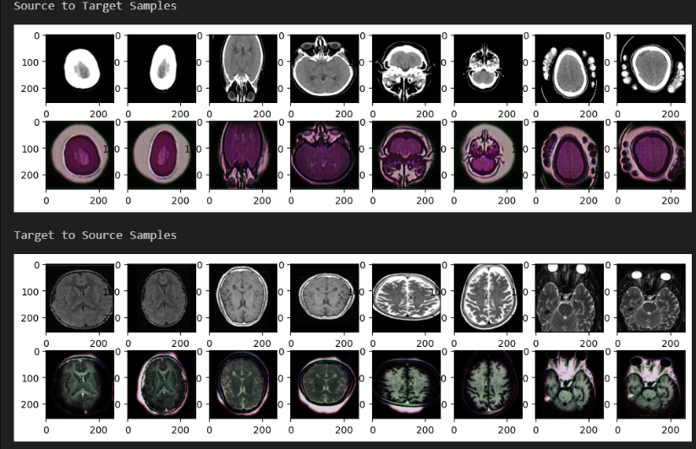
Sample Generation:

Slide 17
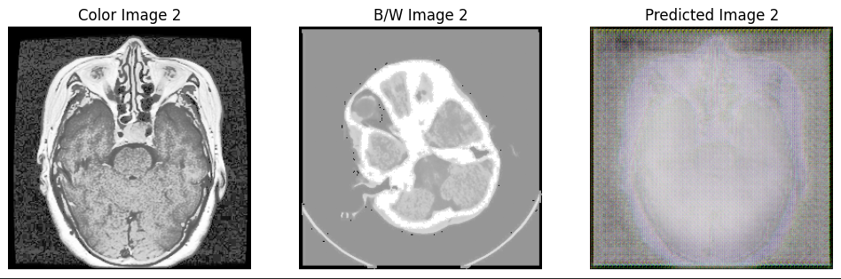
Outputs:

Slide 18
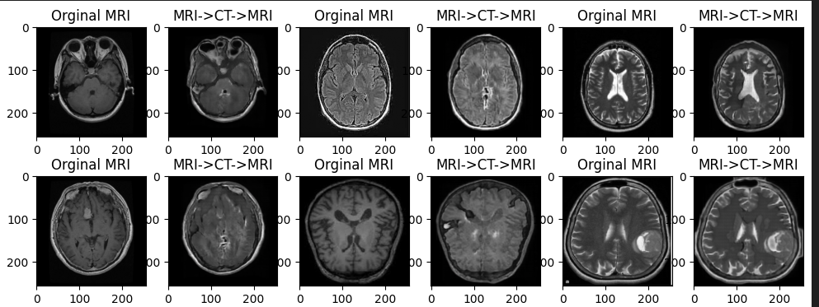
Fine Tuned:

Slide 19
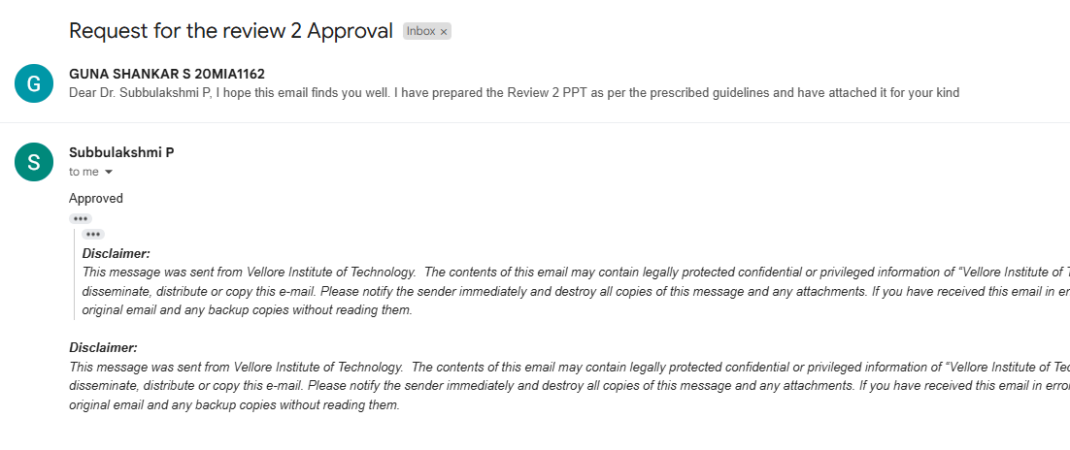
Approval

